Slide 1
Subsidies and Transnational Value Chains in Photovoltaic Industries
Martin Klein & Claudia Meier International Economics Martin-Luther-Universität Halle-Wittenberg, Germany

Slide 2
Outline
The 2013 EU-China trade dispute for solar technology
The need for cooperation and coordination on the international level
Building blocks:
Global public goods
Green National Accounts
Made in the World
Benchmark Cycle
Conclusion

Slide 3
EU-China Solar Technology Trade Dispute
Initiative of ProSun (European Industry Association): Anti-dumping investigation against Chinese manufacturers of PV cells & PV panels
Anti-dumping tariffs of up to 80 % were threatened
Last minute compromise in July negotiated a minimum price for Chinese exports of PV cells & panels to European Union and a maximal quantity.

Slide 4
What's Wrong with World Trade Rules?
Problems linked to the EU-China solar trade dispute
Underlying issue: Pervasive subsidies in clean energy industries
Subsidies are unlikely to go away
clean energy industries are paradigmatic for many other innovative industries
Conclusion
In a world where all trading partners subsidize and will continue to do so, all exporters become vulnerable to trade defense measures initiated by others.

Slide 5
Needed: International Coordination of Clean Energy Subsidies
If national subsidy policies will not disappear and will probably expand further, what is needed is a new approach to clean energy subsidization
Could this be done by or under WTO?
WTO rules envisage none of this
Relevant WTO procedures cannot incorporate coordination
Current trade rounds not able to address this issue
Coordination of clean energy subsidies: how to get there?

Slide 6
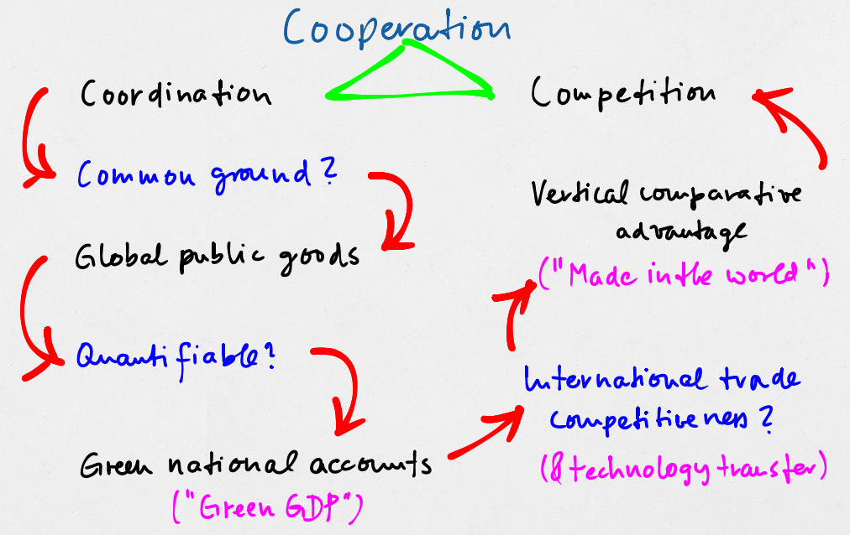
A Back-of-the-Envelope Sketch of the Argument

Slide 7
The Main Building Blocks
Global Public Goods
Green National Accounts
Transnational Value Chains

Slide 8
The Main Building Blocks
Global Public Goods (Karlsson-Vinkhuyzen et al., 2013)
Green National Accounts (Stiglitz et al., 2009)
EU initiative “Beyond GDP”
Pilot projects for Green GDP in China and elsewhere
Made in the World (Maurer, 2011)
WTO initiative to recognize the importance of transnational value chains in international trade

Slide 9
Implementation: Intergovernmental Benchmark Circle
Needed: an institutionalized mechanism for coordinating national clean energy support policies on a supranational level
Intergovernmental Benchmark Circle (Yaeger, 2006)
This would bring the energy technology sector to the same level as, e.g., the financial sector
Long history of international coordination of banking regulation and financial sector regulation

Slide 10
Selected Results
National support schemes for clean technologies
guided by globally agreed goals
reoriented towards performance measures that include environmental quality instead of conventional measures of production or value added
WTO trade protection instruments
focus on trade in value added
and on effective (net) injury in the relevant markets
And should incorporate environmental equality

Slide 11
Thank you for your attention!

Slide 12
References
IEA (2012), World Energy Outlook 2012, released on 12 November , 2012, Paris.
Karlsson-Vinkhuyzen, S. et al. (2013), Global governance for sustainable energy: The contribution of a global public goods approach, Ecological Economics, Volume 83, p. 11-18.
Maurer, A. (2011), MADE IN THE WORLD, Trade in value added: what is the country of origin in an interconnected world?.
Stiglitz, J. E. et al. (2009), Report by the Commission on the Measurement of Economic Performance and Social Progress.
UNCTAD (2013), World Investment Report, Global Value Chains: Investment and Trade for Development.
Yaeger, C. (2006), The Value of Benchmarking, Benchmark Consulting International, Atlanta.

